Slide 1

Basic Details of the Team and Problem Statement
Ministry/Organization Name/Student Innovation:
PS Code: SM960
Problem Statement Title: STUDENT INNOVATION
Team Name: Learnix
Team Leader Name: SATWIK DEY
Institute Code (AISHE): -6242
Institute Name: FUTURE INSTITUTE OF ENGINEERING AND
AND MANAGEMENT
Theme Name: Agriculture, Food Tech & Rural
Development

Slide 2
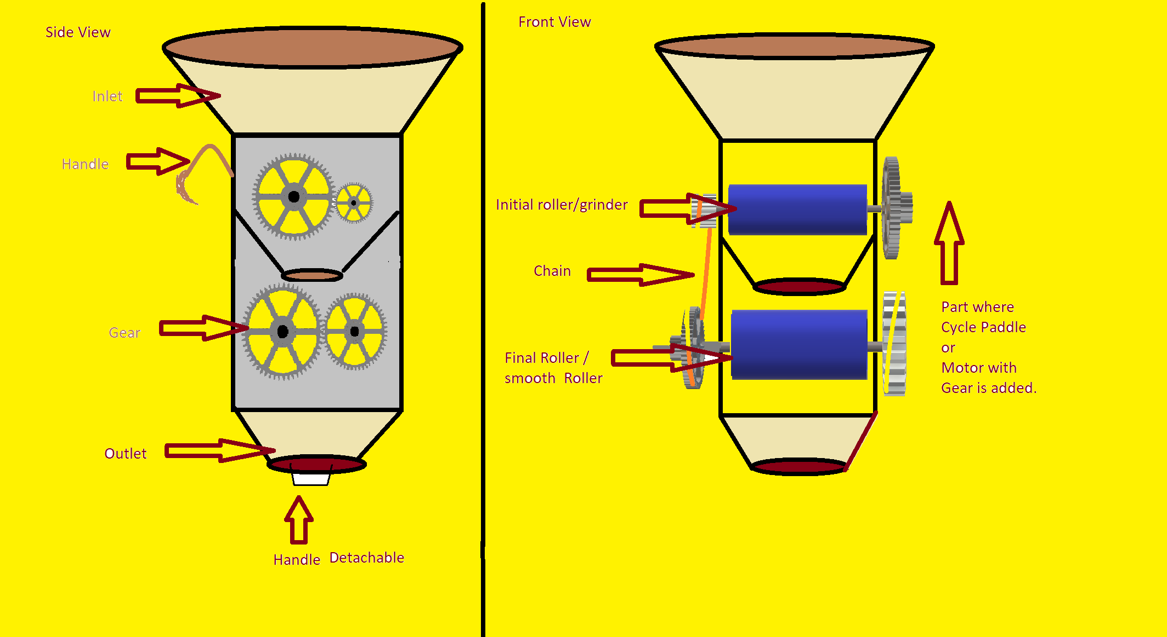
Idea/Approach Details
DESCRIPTION OF THE MACHINE
The machine is a portable flour mill (chakki) which can work with both mechanical and electrical energy.
It can just sit on the carrier of the cycle and can be used just by
attaching a chain with a pedal.
It can also be used just be attaching to a 12 volt motor by a belt.
It is a portable yet heavy duty machine.
It is very simple and very easy to use.
It is suitable for both urban places where electricity is available and
rural places where electricity is not available
It can be used both by end users as well as the shopkeepers.
Describe your Technology stack here:
Plywood/ Iron Sheet
Gear
Cycle Chain / Belt
Teeth Roller (grinder) / Smooth Roller
Spoke
Aluminium Rod
Plastic Pipe

Slide 3
About
70 percent of the population of India is farmers. Wheat is one of the primary cereals in India. But unfortunately electricity is not available in every village and the wheat mills are very few. As a result farmers face a lot of difficulty in producing Maida, Ata , Sooji. They had to travel many miles to go to the mill. Learnix has innovated a milling machine which is semi-portable, heavy duty and it can be operated manually as well as electrically. Now farmers can produce Ata, Maida , Sooji at home easily.

Slide 4
Idea/Approach Details
Describe your Use Cases here
Describe your Dependencies / Show stopper here
Used to produce Sooji, Ata, Maida from wheat.
Can be used both by Mechanical energy and Electrical energy
Very low maintenance cost .
As electricity can be avoided money can be saved while using mechanical energy( by paddling).
Very much portable as a milling machine.
Price is very low when compared with milling machine.
At least one person is required for the operation
Takes more time than industrial milling machine.
At least a paddling machine (Eg. cycle is required for paddling the Roller.
For electrical use you will need a 12 volt motor and belt.

Slide 5
Team Member Details
Team Leader Name: Satwik Dey
Branch (Btech) Stream (CSE ) Year (I)
Team Member 1 Name: Vishal Bhagat
Branch (Btech) Stream (CSE) Year (I)
Team Member 2 Name: Ananya Mondal
Branch (Btech) Stream (CSE ) Year (I)
Team Member 3 Name: Raj Gaurav
Branch (Btech/Mtech/PhD etc): Stream (CSE) Year (I)
Team Member 4 Name: Trinanjan Kumar Baul
Branch (Btech) Stream (CSE ) Year (I)
Team Member 5 Name: Ashish Kumar Singh
Branch (Btech) Stream (CSE) Year (I)

